Slide 1



Slide 2
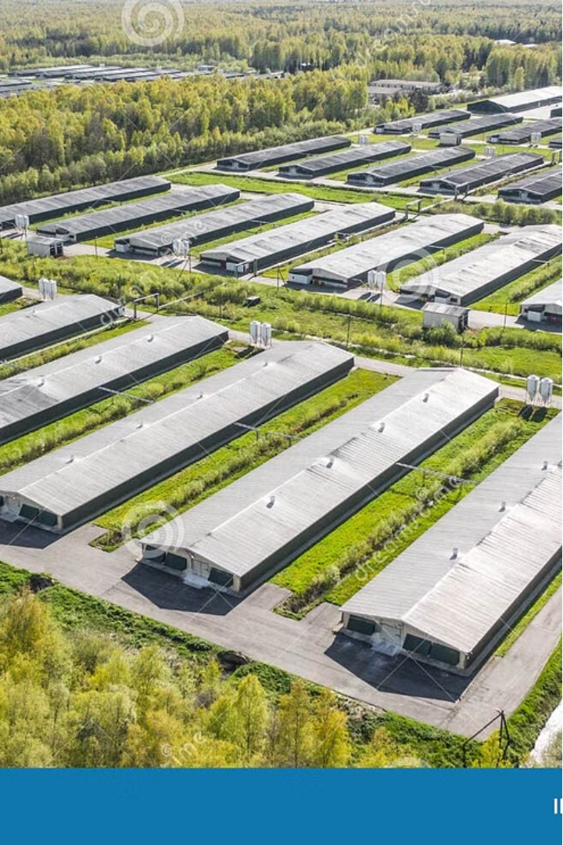
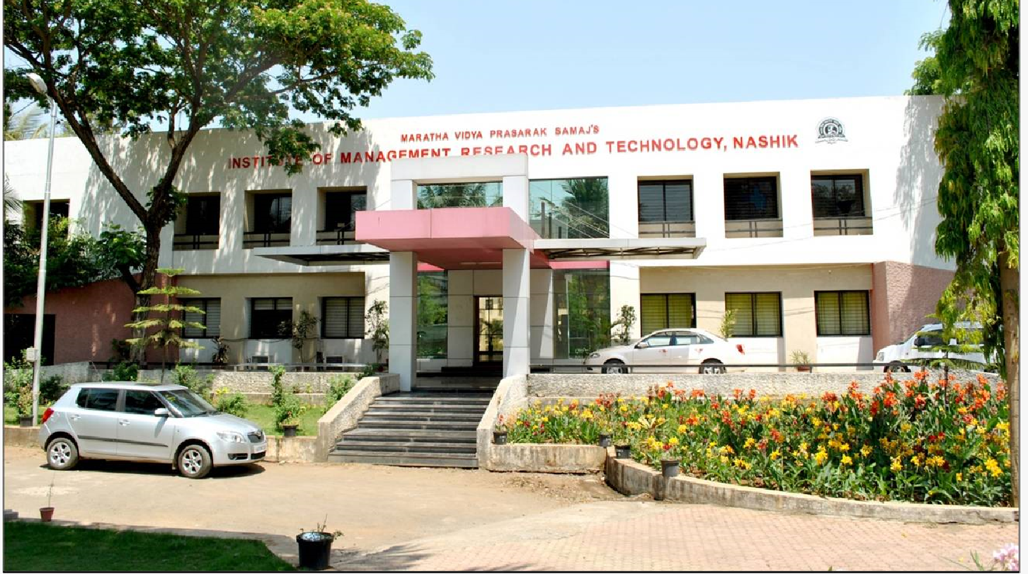

STUDENT INTERNSHIP MANAGEMENT AND TRACKING PORTAL
Intern-Ease is a portal designed for students who have joined internships to create accounts and provide their information for academic use. The platform streamlines the process of managing and tracking student internships, offering a user-friendly interface where students can easily input their details.. Centralized data management creates a unified platform to collect and manage detailed information about students' internships.

Slide 3

Company Profile
Name: Sumago Infotech Pvt. Ltd.
Headquarters: Govind Nagar Nashik, India
Branch Office: Pune, India
Founder:
Our Mission
Our Values
Our Expertise
At Sumago Infotech, we strive with technology to provide the most effective and affordable services that fulfill our customers' needs and budgets. We provide customized websites and software solutions that suit our customers' company objectives. We always involve our customers in the entire process, starting from design right up to deployment, so that your ideas can be incorporated into our work..
We aspire to be the global sourcing choice of the global market and revolutionize the way service processes function. Our goal is to reach out to common people across the globe and make Information Technology a tool for the "Masses", as well as the "Classes". We strive to create innovative IT solutions and provide IT-enabled services to enthrall customers worldwide and build relationships based on Trust, Values, and Professionalism.
Our team of experienced developers and poultry industry experts have created a robust, user-friendly system that caters to the unique needs of poultry farms of all sizes.

Slide 4
Introduction to the Project
1
Comprehensive Farm Management
2
Data-Driven Insights
Leverage real-time analytics to make informed decisions and optimize productivity.
Streamline daily operations, from feed inventory to flock tracking, all in one centralized platform.
3
Seamless Integration
4
Mobile Accessibility
Seamlessly integrate with existing farm equipment and systems for a holistic solution.
Access the system anytime, anywhere, using our user-friendly mobile app.

Slide 5
Objectives of the Study
Increased Productivity
Enhanced Profitability
Streamline operations and optimize resource utilization for maximum output.
Identify cost-saving opportunities and revenue-generating strategies to boost the bottom line.
Improved Animal Welfare
Sustainable Practices
Ensure optimal health and living conditions for the flock through proactive monitoring and management.
Promote environmentally friendly methods and reduce the farm's carbon footprint.

Slide 6

Software and Hardware Requirements
Software
Hardware
Integrations
PHP version 7.0 or higher
Web server with sufficient processing power and memory
The system should seamlessly integrate with existing farm equipment and management tools for a comprehensive solution.
MySQL database server
Apache web server or equivalent
Reliable internet connection for remote access
Responsive web design framework (e.g., Bootstrap)
Sensors and IoT devices for real-time data collection
Backup storage for critical farm data

Slide 7
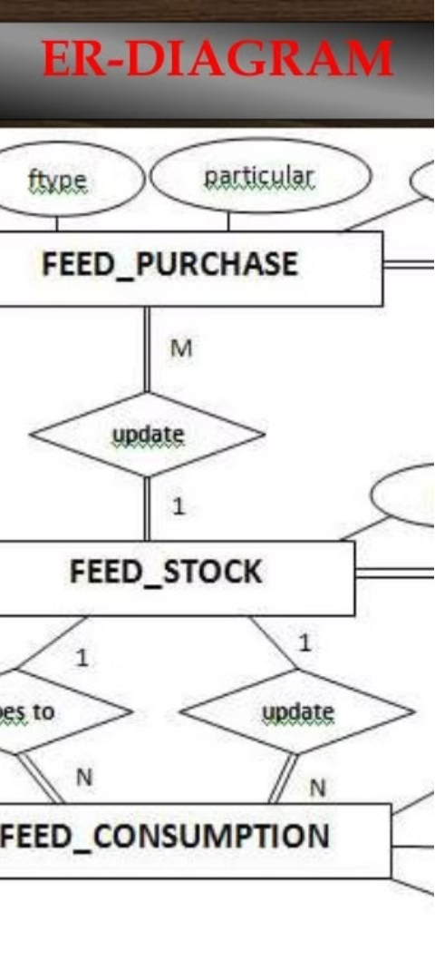
UML Diagrams
1
Use Case Diagram
Depicts the various user roles and their interactions with the system, ensuring a clear understanding of the system's functionality.
2
Class Diagram
Defines the system's object-oriented structure, including the entities, their attributes, and the relationships between them.
3
Sequence Diagram
Illustrates the dynamic interactions between the system's components, helping to design and validate the system's behavior.

Slide 8
Use-Case Diagram
Farm Manager
Veterinarian
Sales Team
Manages farm operations, tracks inventory, and monitors flock health.
Provides medical advice, tracks treatment records, and monitors flock well-being.
Manages customer orders, tracks sales, and generates reports.

Slide 9
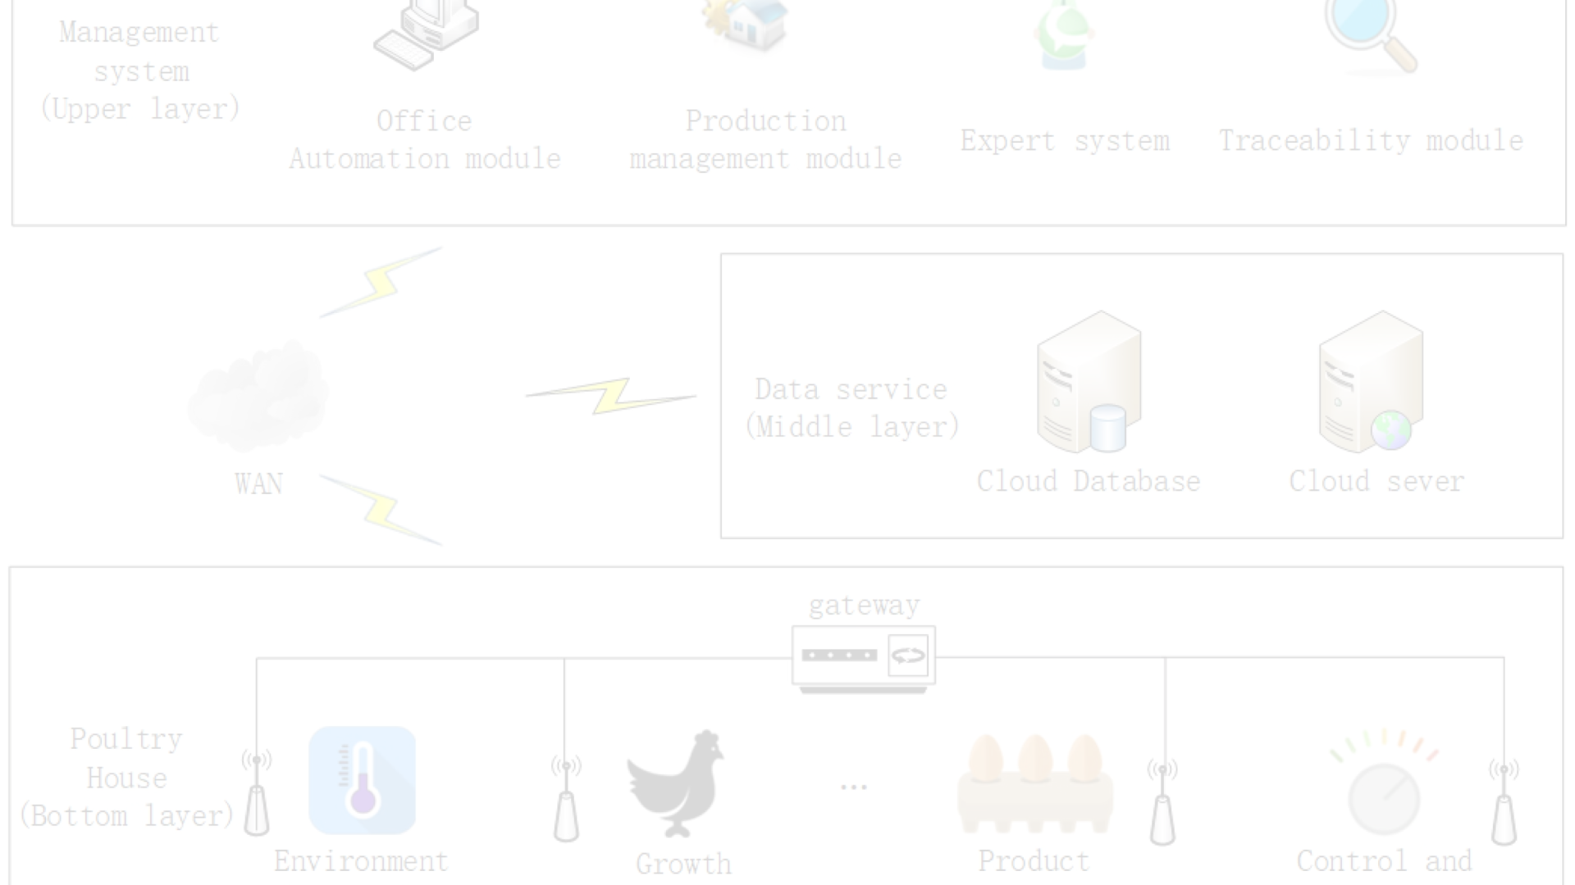
Activity Diagram
Flock Monitoring
Sales and Shipment
Track daily feed consumption, egg production, and other key metrics.
Process customer orders, coordinate product delivery, and generate sales reports.
1
2
3
Inventory Management
Manage feed, medication, and equipment supplies to ensure timely replenishment.

Slide 10
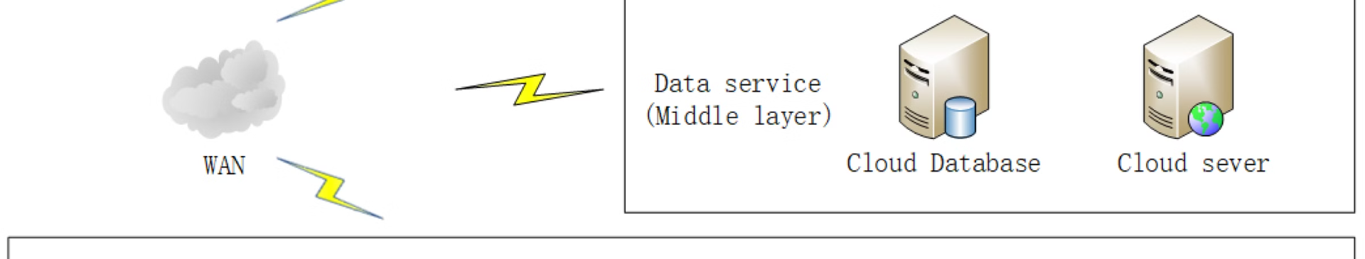



Sequence Diagram
Order Placement
Order Processing
Shipment Confirmation
Customer places an order through the web interface.
The system checks inventory, schedules shipment, and generates an invoice.
The customer receives the order and confirms successful delivery.

Slide 11
Component Diagram
1
User Interface
2
Database
Provides a web-based interface for managing all aspects of the poultry farm.
Stores all data related to flock, inventory, orders, and sales.
3
Reporting Module
4
Notification System
Generates comprehensive reports for decision-making and regulatory compliance.
Sends alerts for low inventory, disease outbreaks, and other critical events.

Slide 12




Deployment Diagram
Web Server
Database Server
Mobile Devices
Network
Hosts the Poultry Management System web application.
Stores all the data related to the poultry farm operations.
Allows farm managers and veterinarians to access the system remotely.
Connects all the components of the Poultry Management System.

Slide 13




ERD Diagrams
Flock Management
Inventory Control
Data Analytics
Equipment Integration
Manage feed, medication, and other supplies to ensure optimal resource utilization.
Leverage real-time data to generate insights and make informed decisions.
Track and monitor the health, growth, and productivity of the poultry flock.
Seamlessly connect with existing farm machinery and sensors for a comprehensive solution.

Slide 14
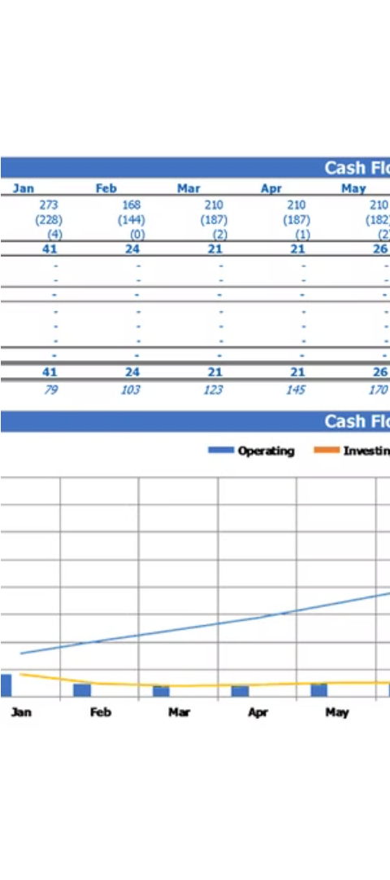



Input and Output Design
Data Entry
Intuitive forms for inputting farm data, such as flock details, inventory levels, and equipment maintenance.
Real-Time Monitoring
Visual dashboards and alerts to track key performance indicators and detect anomalies in real-time.
Reporting and Analytics
Comprehensive reports and data visualizations to support decision-making and identify optimization opportunities.

Slide 15
Database Layout
Flock
Detailed information about each poultry flock, including breed, age, and production data.
Inventory
Track feed, medication, and other supplies, including stock levels, usage, and ordering history.
Equipment
Maintain a comprehensive inventory of farm equipment, including maintenance schedules and repair logs.
Sales
Record sales data, including product types, quantities, and revenue, for detailed financial analysis.

